Slide 1

Secure Messaging with CRYPTON, Rabin Signature and RSA Algorithms Ensuring Confidentiality and Authenticity
Amit Benita 315949594 Guy Edri 315730374 Maxim Lazarenko 324314590 Emanuel Elkobi 212722722

Slide 2

Introduction to CRYPTON
Here’s an overview of how CRYPTON works:
Block Size: CRYPTON operates on 128-bit blocks.
Key Sizes: It supports key sizes of 128, 192, and 256 bits.
Rounds: The number of rounds in CRYPTON depends on the key 128-bit keys use 12 rounds ,192-bit keys use 14 rounds, 256-bit keys use 16 rounds.
CRYPTON's design is similar to that of the AES (Rijndael) cipher, but with some unique differences.

Slide 3

The CRYPTON Rounds
It uses a substitution-permutation network (SPN) structure.
Substitution Layer (S-box): CRYPTON uses 4x4 S-boxes for the substitution step.
There are two S-boxes: one for the encryption process and another for the key schedule.
Permutation – Layer: After the substitution layer, the bits are permuted to achieve diffusion.
The permutation layer is designed to provide a high degree of mixing of the bits across the block.

Slide 4

The CRYPTON Rounds
Mixing Layer: Similar to the Mix-Columns step in AES, CRYPTON uses a linear transformation to mix the bits within a group . This step is essential for providing the necessary diffusion within the cipher.
Key Addition :In each round, a round key derived from the master key is XORed with the block. The key schedule algorithm generates these round keys in a way that provides cryptographic strength and resistance to attacks.
he key schedule in CRYPTON is designed to generate the round keys from the master key efficiently. It uses a combination of the S-boxes and linear transformations to ensure that the round keys are sufficiently independent and provide security against attacks like differential and linear cryptanalysis.

Slide 5

Encryption Decryption in CRYPTON
Encryption: The plaintext is divided into 128-bit blocks. Each block goes through the initial key addition.
The block then undergoes a series of rounds, each consisting of the substitution layer, permutation layer, mixing layer, and key addition. The final round omits the mixing layer.
Decryption: Decryption is achieved by reversing the encryption steps. This involves using the inverse of the S-boxes, permutation, and mixing layers, and applying the round keys in reverse order.

Slide 6

Introduction to RSA and Rabin Signature Algorithms
RSA Algorithm:
RSA (Rivest-Shamir-Adleman) is an asymmetric encryption algorithm widely used for secure data transmission.
It relies on the computational difficulty of factoring large prime numbers.
RSA is used for both encrypting data and creating digital signatures.
Rabin Signature Algorithm:
Rabin signature is a digital signature scheme introduced by Michael O. Rabin.
It is based on the difficulty of integer factorization, similar to RSA.
Rabin signatures provide a method for ensuring message authenticity and integrity.

Slide 7
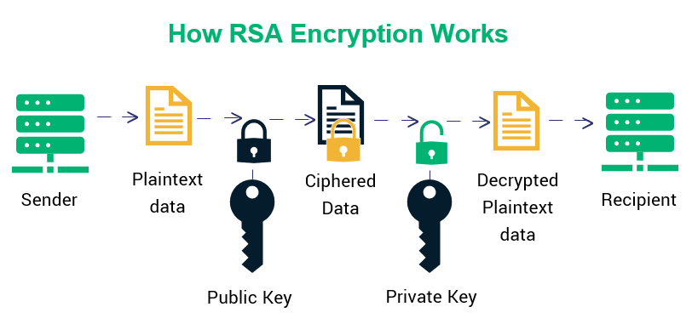
RSA Algorithm Developed by Rivest, Shamir, and Adleman in 1977 Public-key cryptosystem Used for secure data transmission Key components: Public key, Private key Process: Key generation, encryption, decryption

Slide 8
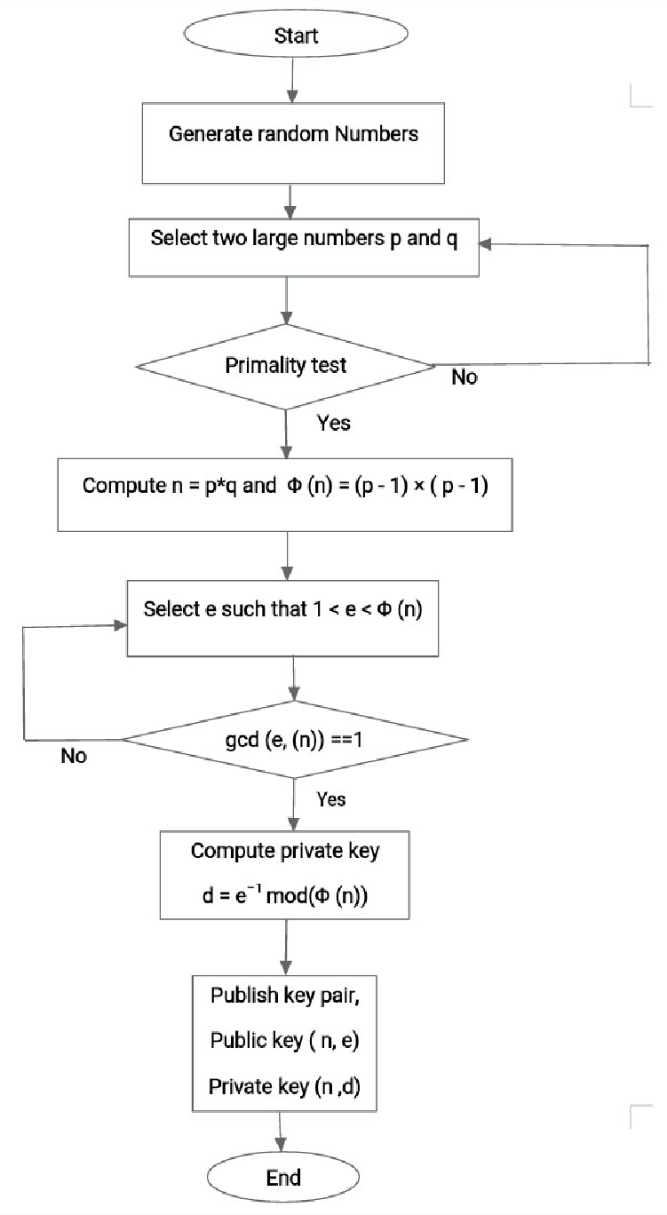

RSA Key Generation
Get key pair: Public key (e, n) Private key (d)

Slide 9
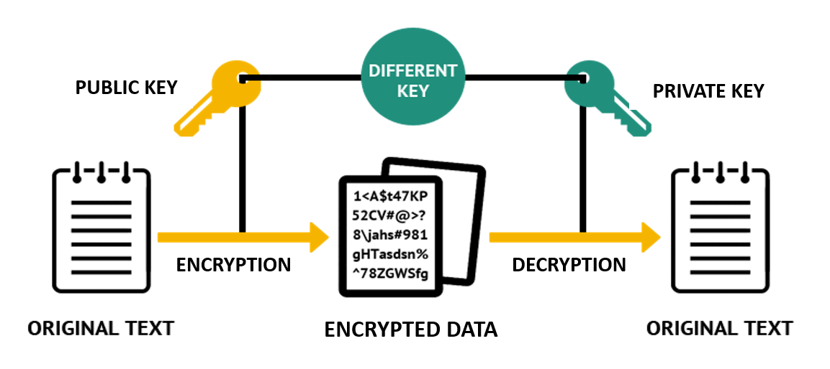
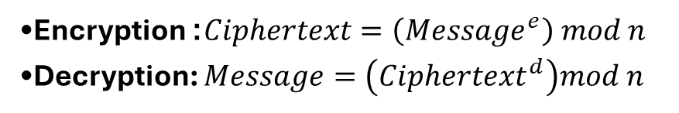
RSA Encryption and Decryption
Encryption: $Ciphertext=\left(Message^{e}\right) mod n$
Decryption: $Message=\left(Ciphertext^{d}\right)mod n$

Slide 10

Rabin Signature
Developed by Michael O. Rabin in 1979
Digital signature algorithm
Based on the difficulty of integer factorization
Key components: Public key (n), Private key (p, q)
Process: Key generation, signing, verification

Slide 11
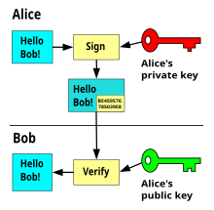

Rabin Key Generation
Choose two distinct primes p and q such that $p≡4 mod 3$ and $q≡3 mod 4.$
Compute $n=p⋅q$
Public key: n, Private key: (p, q)

Slide 12
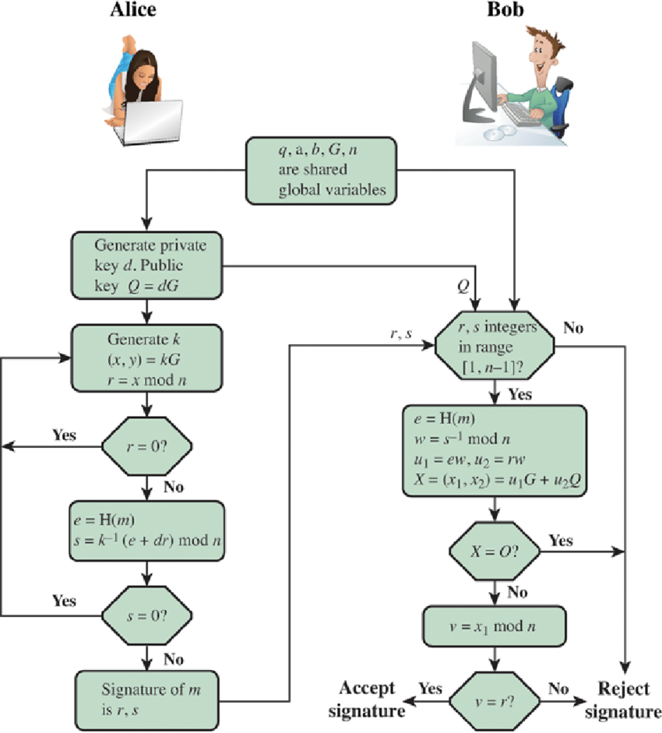

Rabin Signing and Verification
Signing:
Hash the message m to c
Find x such that $x^{2}≡c mod n$
Signature: (x, random string u)
Verification:
Compute c from the received message and u
Check if $x^{2}≡c mod n$

Slide 13

Secure SMS Exchange Example
Encryption:
Sign the message with Rabin Signature.
Encrypt the text using CRYPTON
Encrypt CRYPTON key using RSA (use public key).
Decryption:
Decrypt the CRYPTON key with RSA (use private key).
Decrypt the text using the key with CRYPTON .
Verify the Rabin signature.

Slide 14

Conclusions
The use of both RSA and Rabin Signature algorithms can be used in conjunction to enhance the overall security framework.
The key management is extremely important to maintain the whole system’s security.
Even though both algorithms are considered very secure today, they face potential vulnerabilities from quantum computers.
The design of CRYPTON emphasizes strong security features. The multiple rounds, carefully constructed S-boxes, and robust key schedule provide a high level of resistance to cryptanalytic attacks, including differential and linear cryptanalysis.

Slide 15
Thank You For Listening!

